Slide 1

PGPBABI – OCT 2019 Marketing & Retail Analytics Group Assignment submitted by Prasanna Chandran

Slide 2
Café Great Analysis
Exploratory Analysis
Trends across customer behavior
Menu Analysis
Market Basket Analysis

Slide 3
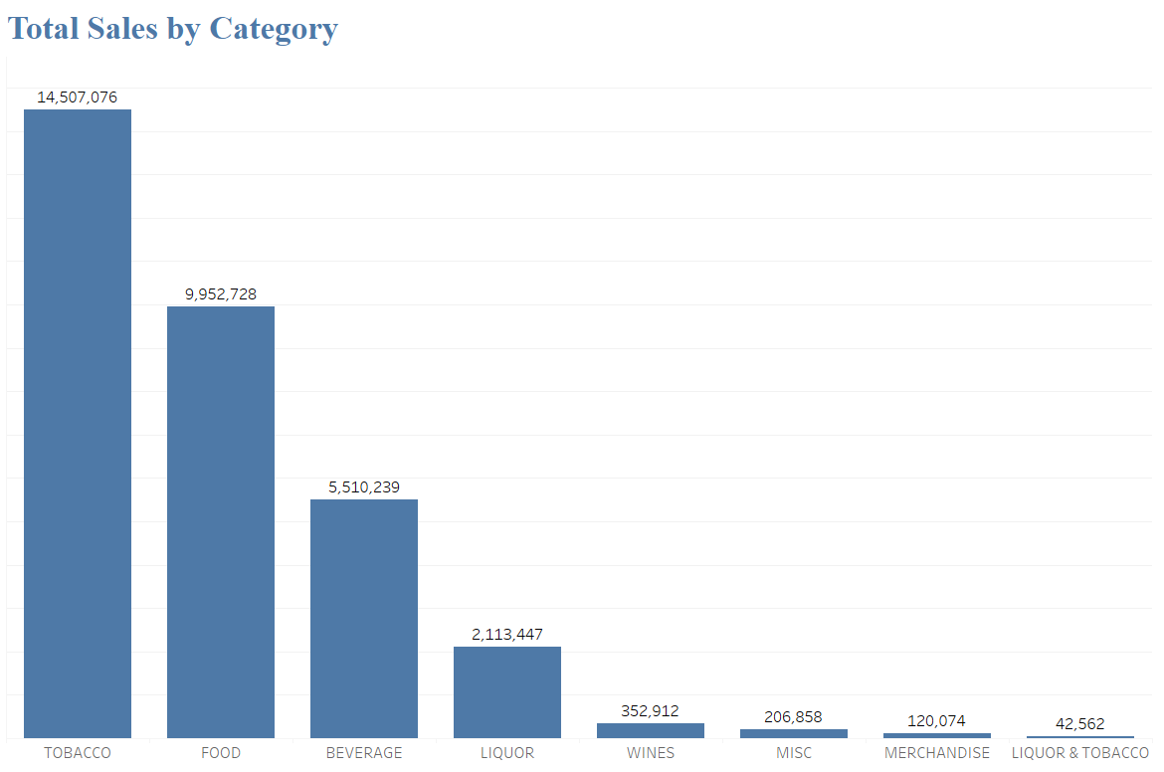
Total Sales by Category
1. Exploratory Analysis
(i) Summary
Tobacco records the highest sale of $14,507,076.
Followed by Food, beverage and Liquor.

Slide 4
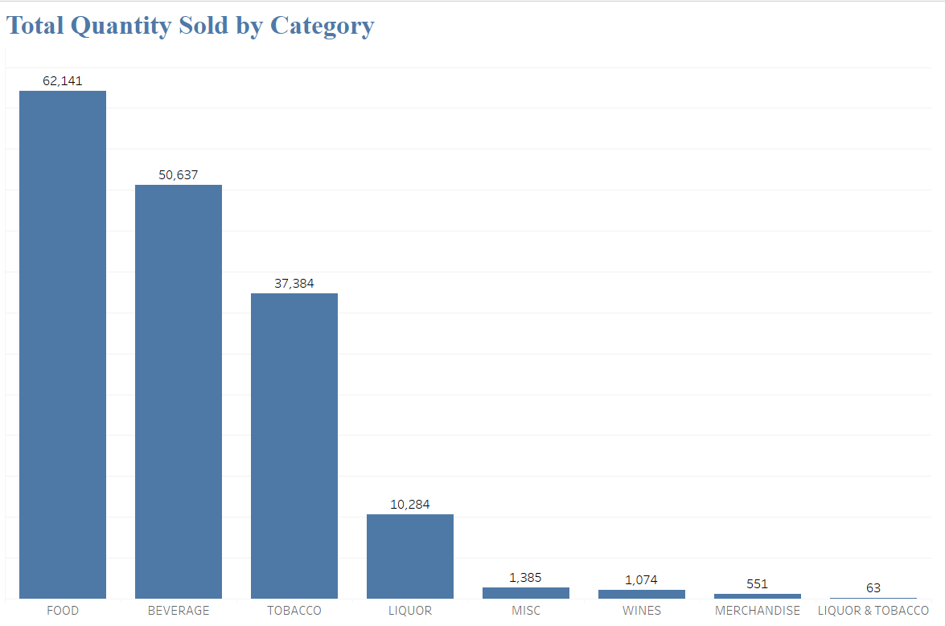
Total Quantity Sold by Category
Food category is highly purchased by customers compared to the other categories.
Followed by Beverage, Tobacco and Liquor.

Slide 5
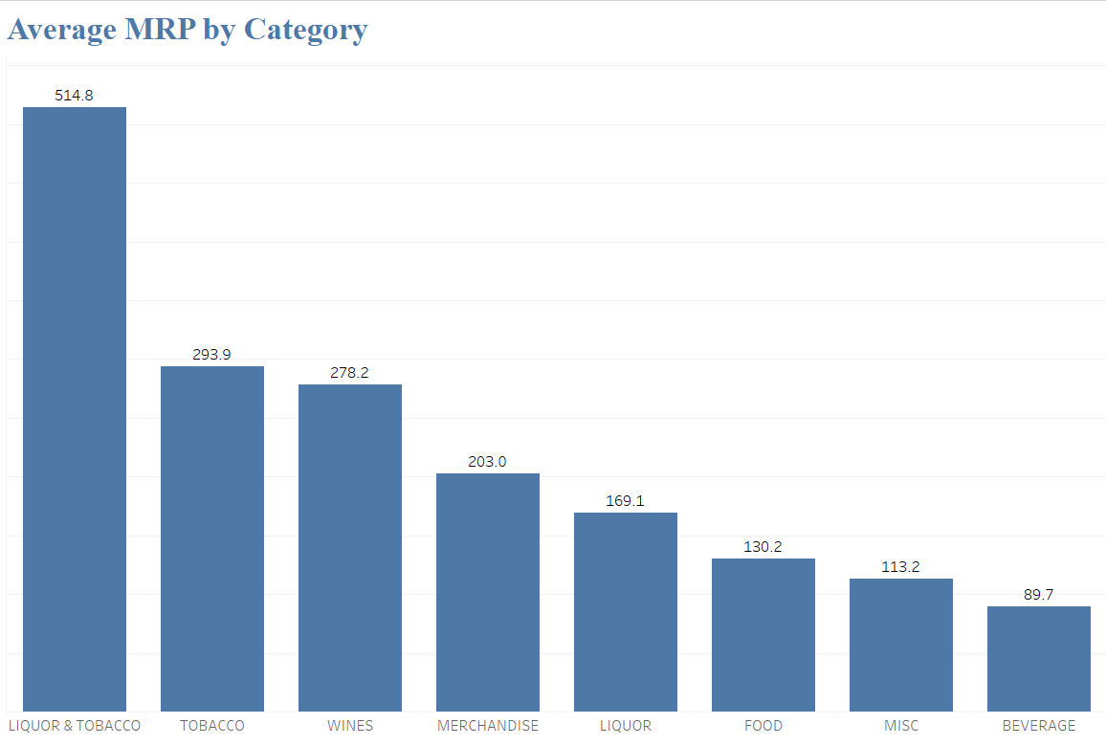
Average MRP by Category
Liquor & Tobacco records the highest MRP on average of $ 514.80.
Followed by Tobacco, Wines, Merchandise and Liquor.

Slide 6
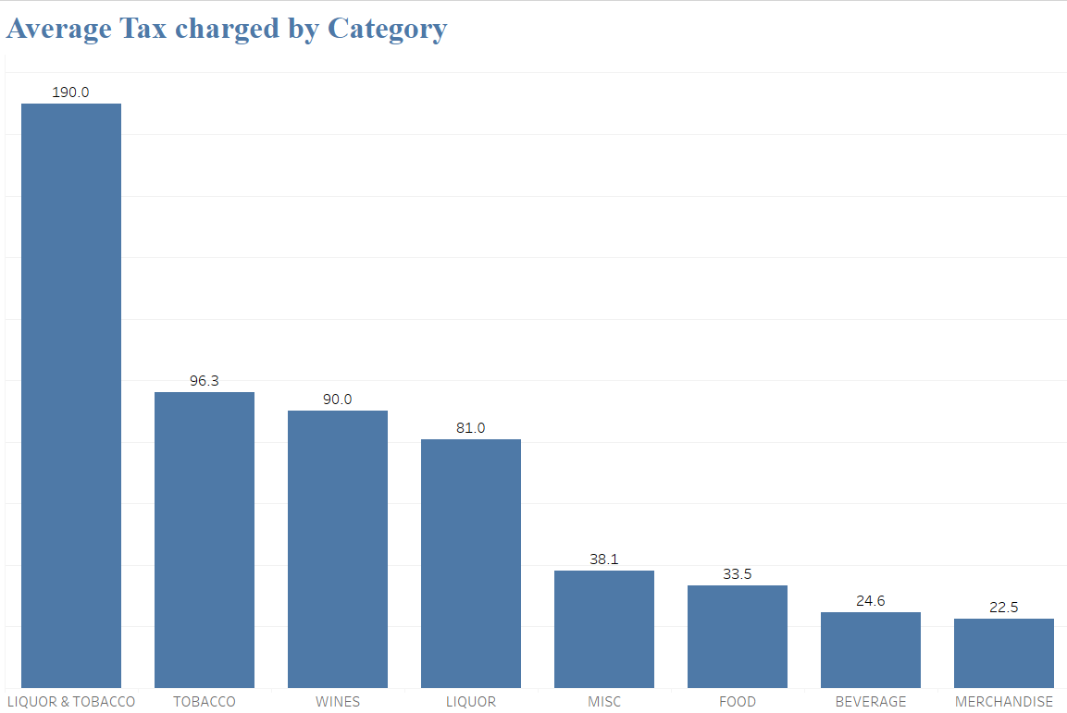
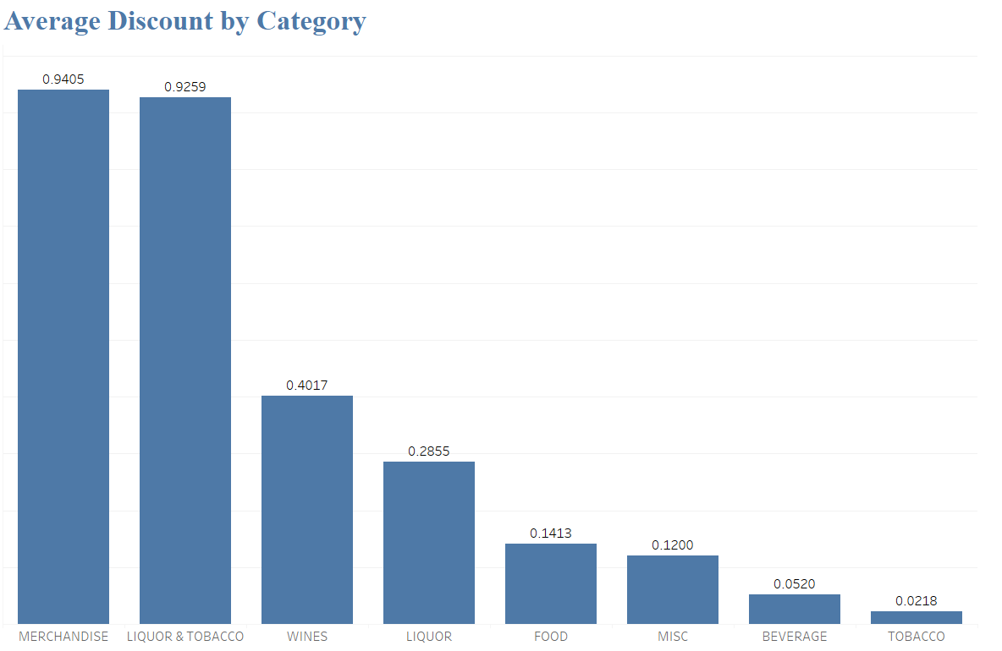
Tax Charged by Category
Liquor & Tobacco has the highest tax charges on average of $ 190.00.
Followed by Tobacco, Wines, Merchandise and Liquor.
Tax rates are one of the key factors for higher MRP.
Discount by Category
Merchandise tends to get the highest discount of $0.94 on average.
Followed by Liquor & Tobacco, Wines, and Liquor.

Slide 7
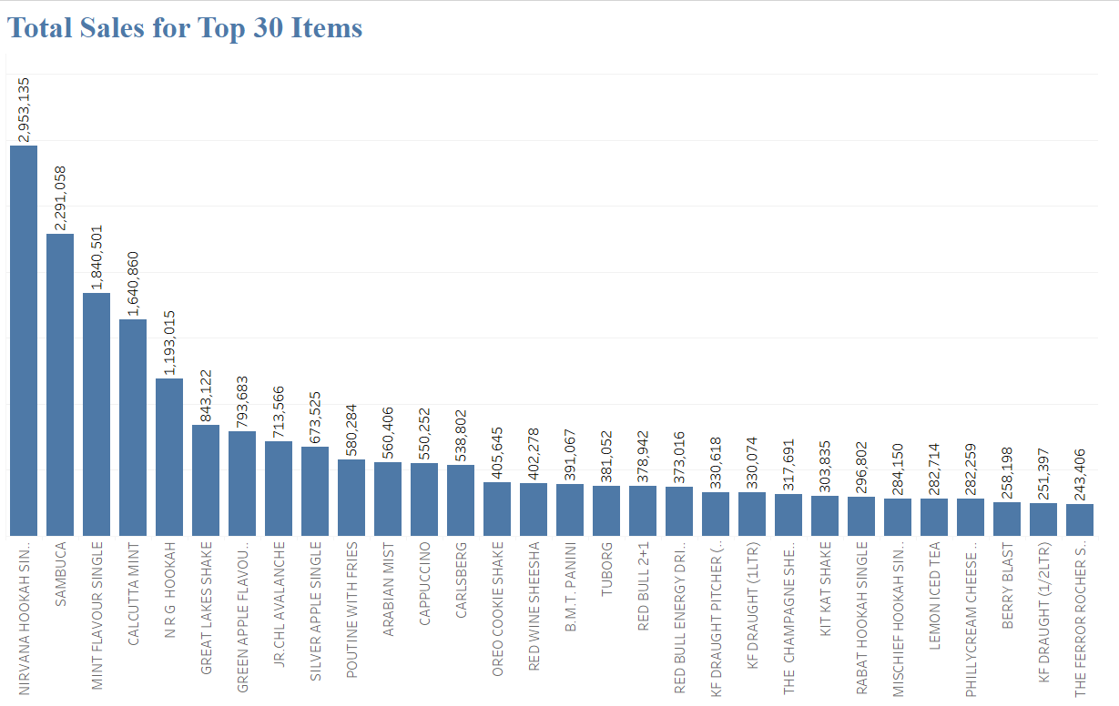
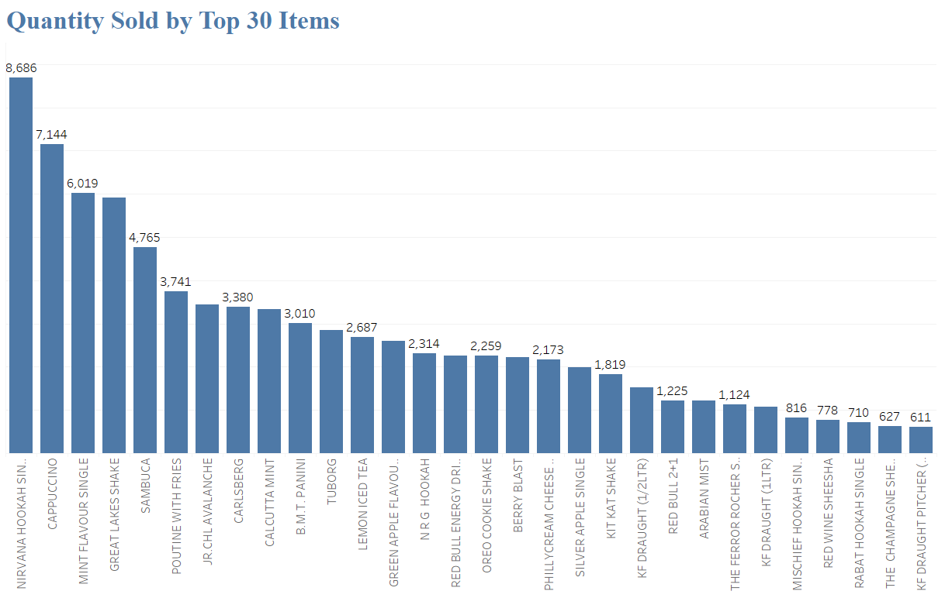
Total Sales vs Quantity Sold (Top 30 Items)
Total Sales
Nirvana Hookah records the top sales worth of $2,953,135.
Followed by Sambuca, Mint Flavor Single, Calcutta mint.
Total Quantity Sold
Nirvana Hookah is highly sold item
Followed by Cappuccino, Mint Flavor Single, Great Lakes Shake.
Its observed people prefer tobacco along with a beverage.

Slide 8
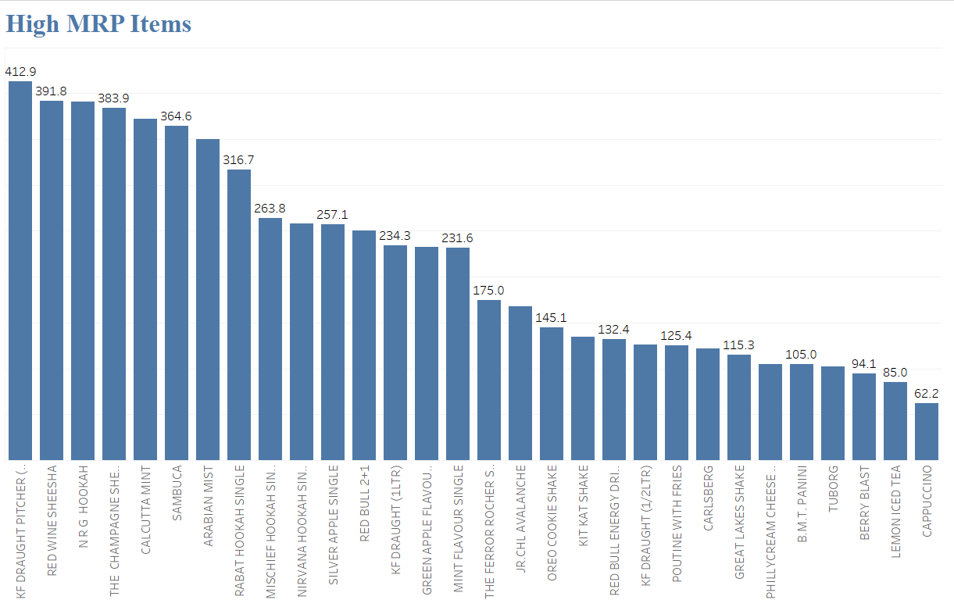
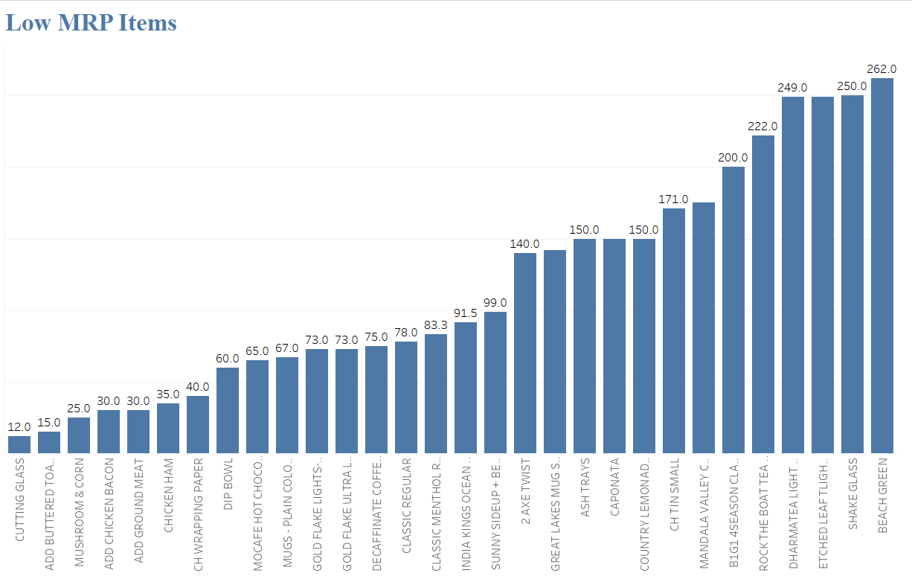
MRP Items
High MRP Items
KF Draught Pitcher is the costliest item
Followed by Red wine sheesha, NRG Hookah and champagne
Liquor and tobacco items tend to have higher MRP
Low MRP Items
Cutting Glass is the cheapest item
Followed by Add buttered toast, mushroom and corn, chicken bacon
Food items tend to be the items with cheapest MRP

Slide 9
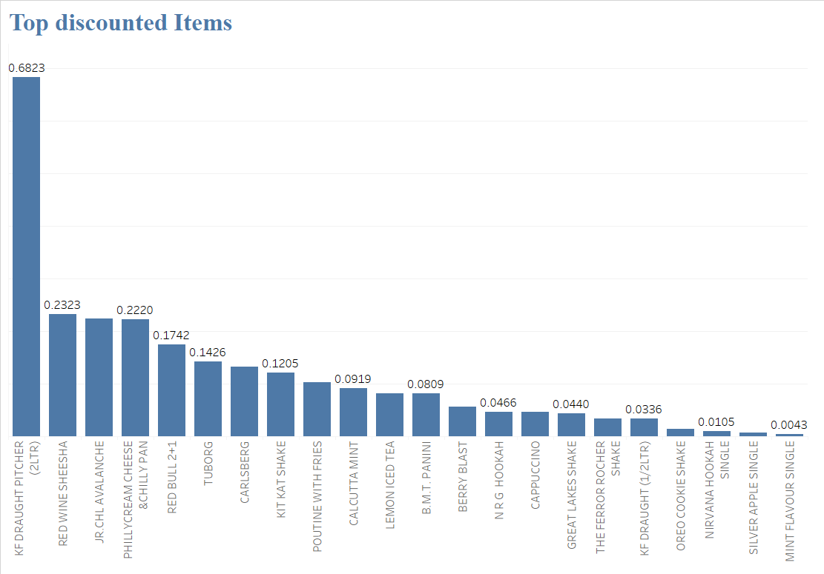
Top Discounted Items
Despite KF Draught being the costliest item, it also gets the highest discount on average.
Followed by Red wine sheesha, avalanche, Philly cream cheese.
Discounts tends to be given to the items across all categories.

Slide 10
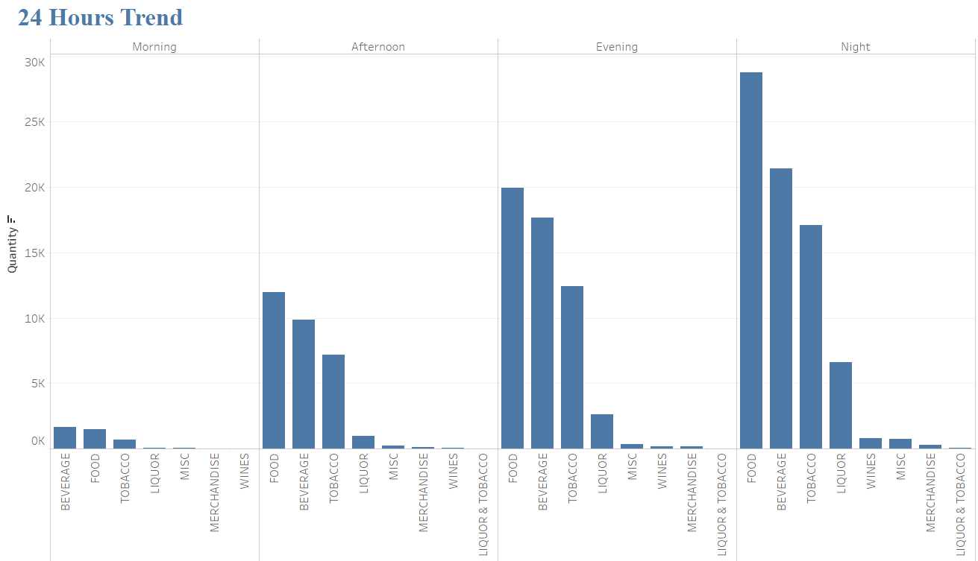
(ii) Consumer Behavior Trends
Morning – Not much sales observed in the morning. Top selling categories are Beverage and Food.
Afternoon – A moderate sales occur in the noon, best selling items are Food, Beverage and Tobacco.
Evening – The sales is good, top sellers are Food, Beverage, Tobacco & Liquor.
Night – High sales happen during the night. Best sellers are Food, Beverage, Tobacco, Liquor & Wines.

Slide 11
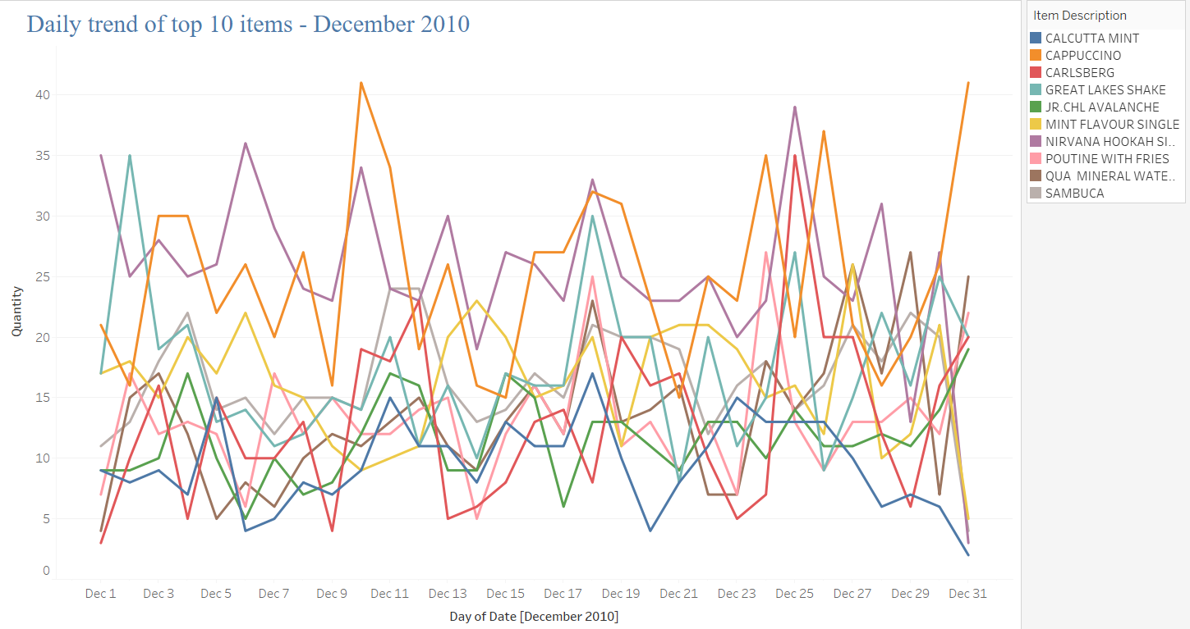
Daily Sales Trend for Top Ten Sold Items (each week in December 2010)
Analyzing the day wise trend for the entire year could be huge, so the graph comprises of day wise sale for the month of December 2010
Beverages, water, tobacco & basic food items like fries are the mostly bought on daily basis
Cappuccino records high sales on maximum days.

Slide 12
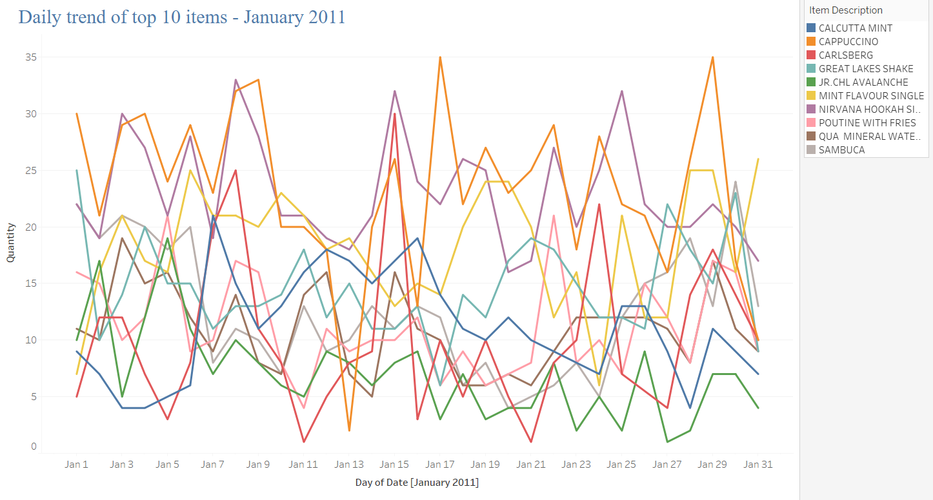
Daily Sales Trend for Top Ten Sold Items (each week in January 2011)
Daily sales trend for January 2011
Cappuccino records a higher daily sales followed by Nirvana Hookah
Other beverages and tobacco brands tend to have a daily moderate sales

Slide 13
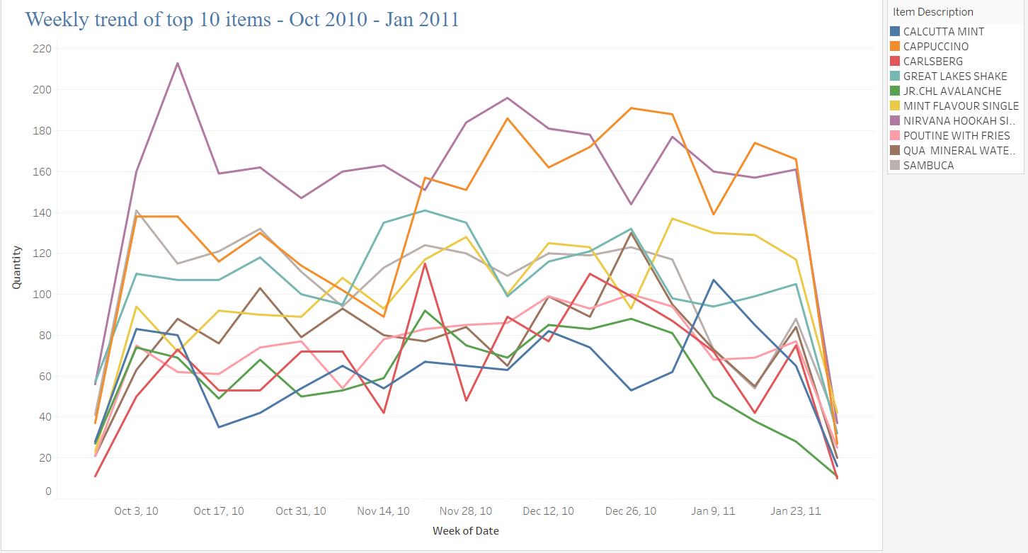
Weekly Sales Trend for Top Ten Sold Items (Oct 2010 - Jan 2011)
Nirvana Hookah records a higher weekly sales followed by Cappuccino. They seem to be mostly bough together
Carlsberg tend to have a higher sales during the weekends
Sales for all the items tend to be higher during the end of December, which is usually the festive week and the holiday season.

Slide 14
Recommendations Based on Daily/Weekly Sales
Cappuccino and Nirvana hookah tend to have high sales on daily basis. There are other beverages and tobacco record a moderate daily sales. Café can identify the beverages or tobacco brands that yield low sales and give discount on one of them, ideally customers would buy the discounted item and buy the other item for the full MRP.
Café Great can place the commonly bought items at different corners of the café and place the low sales items in between them, so that the customer would be willing to buy alternate items along with their usual purchase.
Placing attractive banners and posters for items with low sale could attract the customers to try alternate brands.
Telecasting customized advertisements based on time of the day can earn more sales for the appropriate category. For example: Liquor sales are higher during the nights.

Slide 15
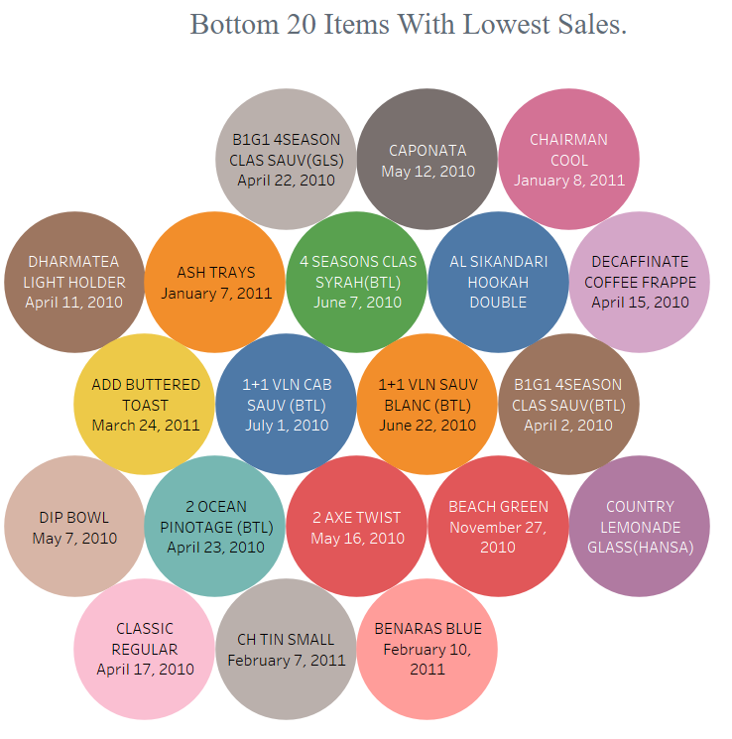
(iii) Should Café Great remove certain menu items?
“Consumer preferences are always changing, and if Café Great wants the best chance of success, they need to stay knowledgeable with current trends.”
Twenty Items listed along with their purchase date indicates the lowest sold items throughout the year. They are least popular and have been sold only on those specific dates.
Café Great should reconsider to remove these products, as they only occupy the shelf space and obtains very less sales.
Replacing these products with actively sold items can generate more revenue and make the restaurant seem more trendy, subconsciously convincing guests to spend more.

Slide 16
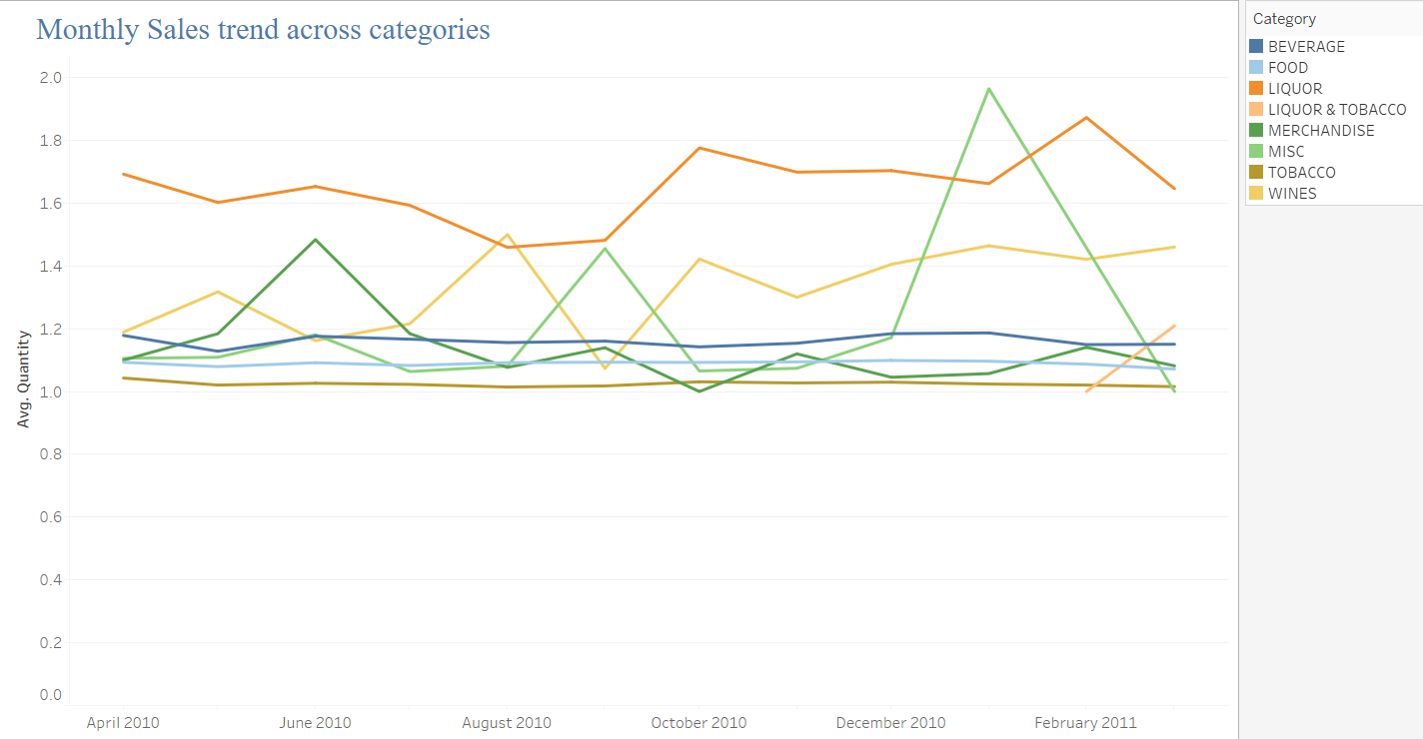
Monthly Sales Trend
(iv) Monthly Trends
Liquor records the highest sales in most of the months.
Food, tobacco and beverages shows a static customer purchasing behavior across months.
Wine sales seems to go higher around the winter season, due to the Christmas and New years.
Misc. items tend to have a drastic sale during year ends and this could be also be due the holiday and festival requirements.
Merchandise records high sales during the beginning of the year and then gradually decreases.

Slide 17
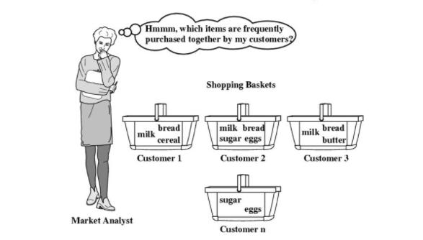
2. Menu Analysis
Finding relations between objects, for example, most of the people must have bought bread if they have bought butter. So, some supermarkets keep the objects that have high probability of being purchased together in same aisles while other may keep them in two different corners so that the customer while finding their necessity would browse and purchase other products.
Market Basket Analysis is an example where buying habits are analyzed and rules are established based on the customer’s “buying habits”. Patterns are represented in the form of rules.

Slide 18
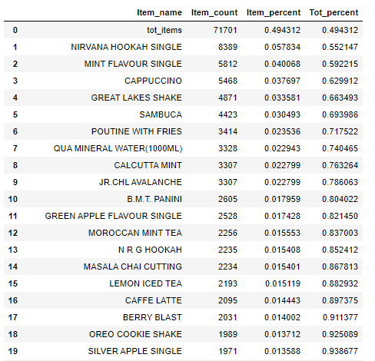
Top Twenty Contributors !
Top 5 Items contribute 66.34% of quantity sold
Top 20 Items contribute 93.86% of quantity sold

Slide 19
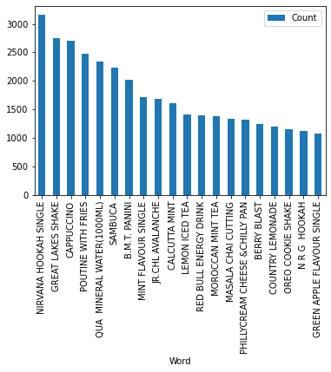
Frequently Bought Items !
By performing Market Basket Analysis, we understand the items shown in the image are the frequently bought items.
Frequently Bought Items

Slide 20
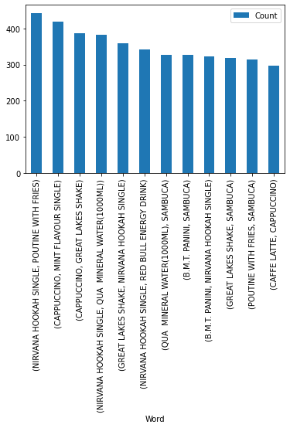
Frequently Bought Combos !
By performing Market Basket Analysis, we understand the items shown in the image are the frequently bought combo items.
Nirvana Hookah & Poutine with Fries is the most frequently bought combo.
Frequently Bought Combo Items

Slide 21
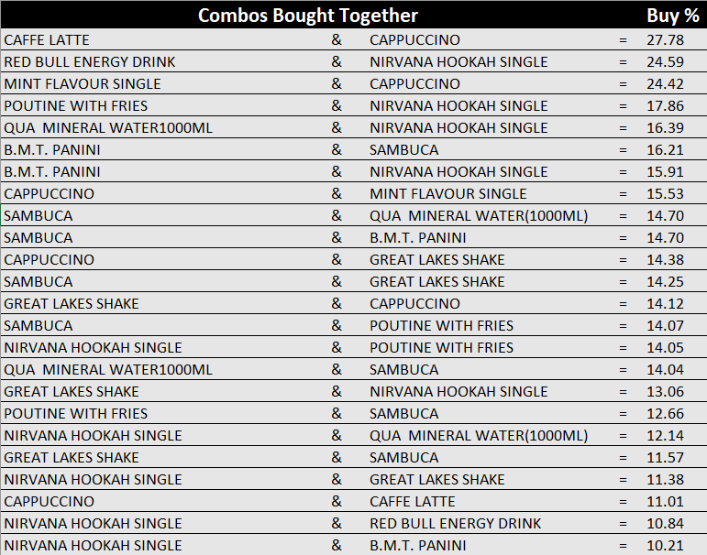
Recommended & Popular Combos !
The popular combos for Café Great are shown in the image, sorted based on their highest buy percentage.
Café Great should design their shelves based on these key combos, so that they can retain sales of the current combos and attract customers to buy other items.
Placing other items in between these preferred combos can earn more sales for other products.

